Slide 1
USC Transition to Blackboard Learn Ultra
An update on the University of South Carolina's transition from Blackboard Learn Original Course View to Blackboard Learn Ultra Course View.
A Provost’s Office initiative in collaboration with the Division of Information Technology.

Slide 2
Spring 2024 - Important LMS Dates
Friday, March 15, 2024: Summer 2024 course shells available in Blackboard (Bb Original View)
Zoom will replace Collaborate in Summer 2024 courses
Student Attendance Quiz pilot
Week of March 25th: Zoom LTI Tool available in Blackboard
Zoom will replace Collaborate in Summer 2024 courses
Friday, March 29, 2024: Fall 2024 course shells available in Blackboard (Bb Ultra Course View)
*Beaufort exception (will move to Ultra in Spring 2025 – Oct 31, 2024 Spring course shells created)
Student Attendance Quiz Go-Live – Fall 2024 semester
May 15th, 2024 – Collaborate will be made unavailable in our Blackboard Instance
Collaborate recordings from Spring 2024 will be archived by eLS
Collaborate recordings from August 2020 – May 2024 will be archived for 1 year
July 2024 – Blackboard Contract Renewal

Slide 3
UCV Training opportunities
Blackboard Days: in-person only, hands-on sessions (laptop encouraged)
APR 16 — Blackboard Day: Collaborative and Personalized Learning in Blackboard Learn UCV - In Person — 10:00 a.m. - 3:00 p.m.
MAY 15 — Blackboard Day: Gradebook Management in Blackboard Learn Ultra Course View (UCV) - In Person — 10:00 a.m. - 3:00 p.m.
JUN 20 — Blackboard Day: Artificial Intelligence in Blackboard Learn Ultra Course View (UCV) - In Person — 10:00 a.m. - 3:00 p.m.
JUL 29 — Blackboard Day: Getting Started with Blackboard Learn Ultra Course View (UCV) - In Person — 10:00 a.m. - 3:00 p.m.
AUG 15 — Blackboard Day: Getting Started with Blackboard Learn Ultra Course View (UCV) - In Person — 10:00 a.m. - 3:00 p.m.
UCV Training Offerings (virtual) - Spring 2024 (Summer/Fall 2024 dates – coming soon!)
Virtual Trainings and Open Q&A Office Hours offered by eLS and Center for Teaching Excellence (CTE) – please register:
https://sc.edu/about/offices_and_divisions/cte/events_calendar/blackboard_learn_ucv/index.php
Other: Departmental Meetings, Trainings available

Slide 4
Zoom Implementation
Where are we at with implementing Zoom?
Single Sign-On (CAS) – scheduled go live – Thurs 3/28
Zoom Account Provisioning – in progress – Plan A – Provision all users
Plan B
Instructors teaching courses in Summer 2024 and Fall 2024 will be provisioned first
Multiple Microsoft tenant users – work in progress with USC Teah team/Zoom
All others to follow – non-academic users
Zoom Account Consolidation – working with Zoom technical team – 2000+ accounts/users - more to come
Zoom User Training: Coming soon! (April 11th in Bb UCV 101 training)
When can we expect to see Zoom available in Blackboard?
Week of March 25th: Zoom Tool will be made available and need to be added manually to a course by instructors
Zoom will replace Collaborate in Summer 2024 courses and beyond
Zoom recordings stored in Panopto (configured to automatically save recordings here on the backend)
Zoom – Original Course View: Course Tools – Zoom
Zoom – Ultra Course View: Books & Tools/Content Market

Slide 5
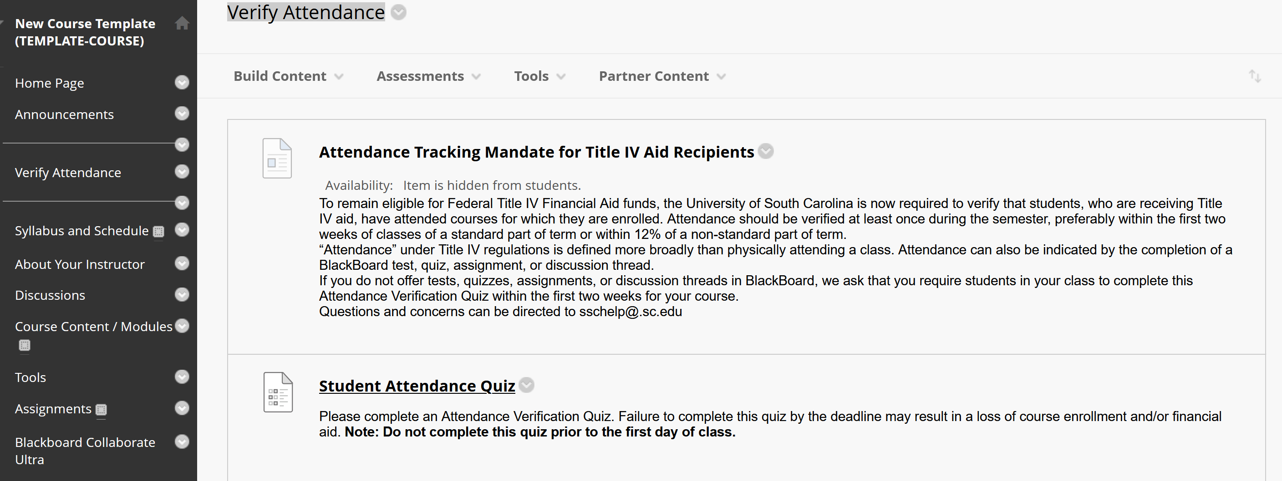
Title IV Attendance Mandate
Student Attendance Quiz placed in default course templates in Blackboard
No due date – Instructors have been asked NOT DELETE THIS content and to instruct students to take the quiz after the start date of the course and within the first 2 weeks
0 point value test – will not count towards final grade
No category – not in the test category so will not calculate into final grades but will appear in the gradebook to show complete or incomplete
Original Course View
Ultra Course View
For further questions and support- sschelp@sc.edu
Notes:
Backend process scans Bb and send info to Banner
For further questions or concerns - sschelp@sc.edu

Slide 6
Sunset of Collaborate
May 15th, 2024 - Collaborate will be made unavailable in Blackboard
Summer semester starts May 1st, 2024 (Small overlap with Collaborate and Zoom both being active)
Collaborate recordings from Spring 2024 will be archived
Collaborate recordings from August 2020 – May 2024 will be archived for ~1 year
Faculty should start migrating ALL collaborate recordings to Panopto NOW
KB Article

Slide 7
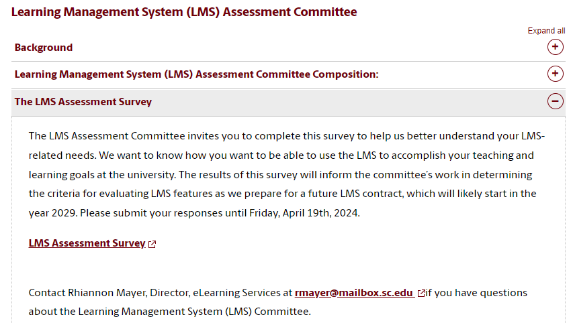
LMS Assessment Committee and survey
The Provost and the Faculty Senate at USC Columbia initiated the charge for what is called the Learning Management System (LMS) Assessment Committee. We have been charged with evaluating the needs of Instructors, Staff, and Students here at the University to inform future decisions regarding our Learning Management System (LMS).
Survey live on Wednesday, March 20th: (further communications coming)
Located here: https://go.sc.edu/ultra - LMS Assessment Survey

Slide 8
USC UCV Resources for faculty
Columbia Office of the Provost Website – Transitioning to Blackboard Learn Ultra – http://go.sc.edu/ultra
Blackboard Learn Ultra Resources – CTE Website - http://go.sc.edu/ultraresources
Small group trainings and consultations by request from eLS and CTE
Meet with an Instructional Designer at Center for Teaching Excellence (CTE)
Consult with a Blackboard Admin with eLearning Services
UCV Decision Tree – get thinking about which conversion option will work best for you!
UCV Conversion Video - demonstrates the steps of the conversion process.
Post Conversion Checklist - ensure your course is fully prepared for teaching in the UCV environment
CTE Template - import into your Ultra sandbox and/or your existing Ultra course.
Notes:
LMS Support Partners are available to assist faculty with this transition on the Columbia campus and comprehensive campuses. Please reach out to them for more information.

Slide 9
Thank You!
Rhiannon Mayer
Director of eLearning Services
Division of Information Technology
rmayer@mailbox.sc.edu

